Slide 1
Greens of each group grab your group’s homework folder & enough quarter sheets of paper for your group.
All you need on your desk today is a pencil
Write your name, the period, and the date in the upper right hand corner of your paper.
Answer the following question:
What needs to happen to work effectively as a group?

Slide 2
Group Roles

Slide 7
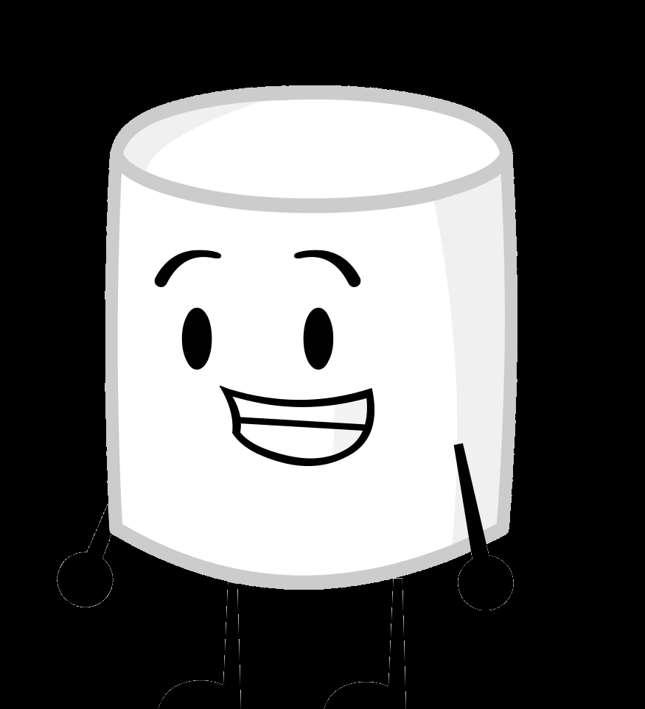
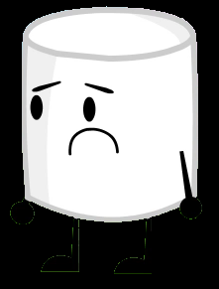
Marshmallow Challenge

Slide 8
Supplies
Groups of 3 or 4
Each group gets:
20 spaghetti noodles
One 3-foot length of string
One marshmallow
3 feet of Masking Tape

Slide 9
THE CHALLENGE
Build the Tallest Freestanding Structure
The Entire Marshmallow Must be on Top and it must remain whole
Use as Much or as Few of the Supplies as you want
You may break up the Spaghetti, String, or tape
The Challenge lasts 18 minutes

Slide 10
Conclusion Questions
What building techniques make the tower stronger?
Does the placing of the marshmallows affect the strength of the tower?
Could you build a stronger tower with more of the same materials? What alternative materials would be better?
Does the size of the base alter the strength of the tower?
How do you think you worked as a group? Did you assume different roles? Did all groups work in the same way?

Slide 11
What worked?
Did everyone fulfill their group role?
What didn’t work?

Slide 12
Reflect
Look back at the handout on group roles and read what your responsibilities were.
Individually answer the following questions:
--What part of your roll did you do well?
--What part of your roll could you have done better to make this activity more successful?

